Slide 1
Home In Tacoma Project
TPAG
January 17, 2024

Slide 2
Revised project schedule
July to Dec 2023
Jan to April 2024
May to July 2024
Develop full package
EIS Consultation
Planning Commission Public Hearing
Release Draft EIS
Planning Commission recommendation
City Council review
Release Final EIS
Council Public Hearing
Council action
PRIOR WORK
HIT 1 policy direction
HIT 2 Round 1 & 2 engagement
2023 legislative direction
Frequent Council guidance
Ongoing engagement throughout

Slide 3
Agenda
Objectives (Planning Commission meeting)
Authorization to release for public review - February 5 to Mar 8, 2024
Set public hearing date - Wednesday, 03/06
Final changes to Package - Landscaping Code, amenity space, setbacks
Input on engagement approach - notice, info meetings, online platforms, key stakeholders
Provide awareness of
Site Planning Exercise - how do housing, access, utilities, trees, etc. fit?
Draft EIS Initial Findings – topics studied, likely impacts, mitigation actions

Slide 4
What’s in the public review package
Summaries
Zoning Code track changes edits
Maps (interactive online versions)
Draft EIS
Technical memos (market analysis and bonuses, site planning exercise)

Slide 5
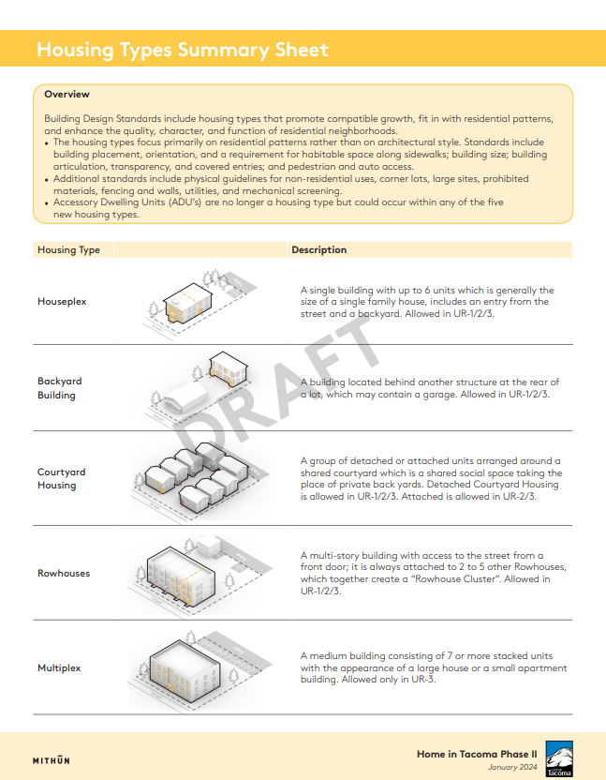
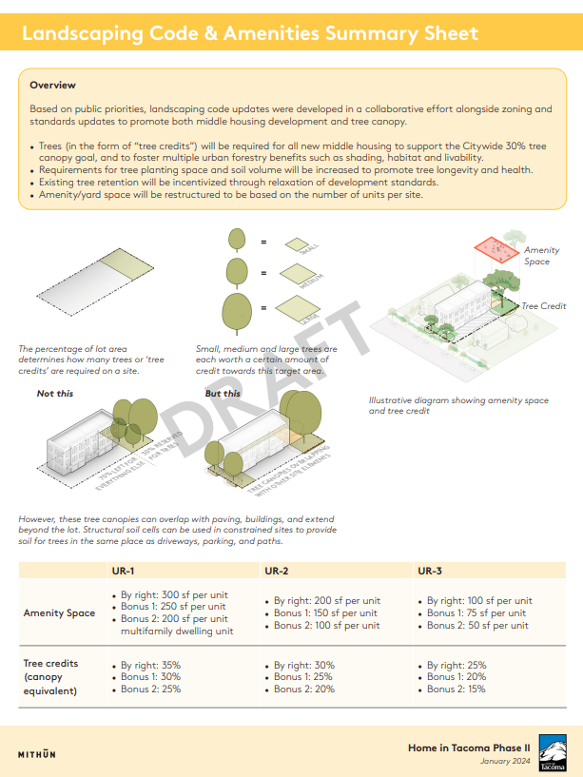
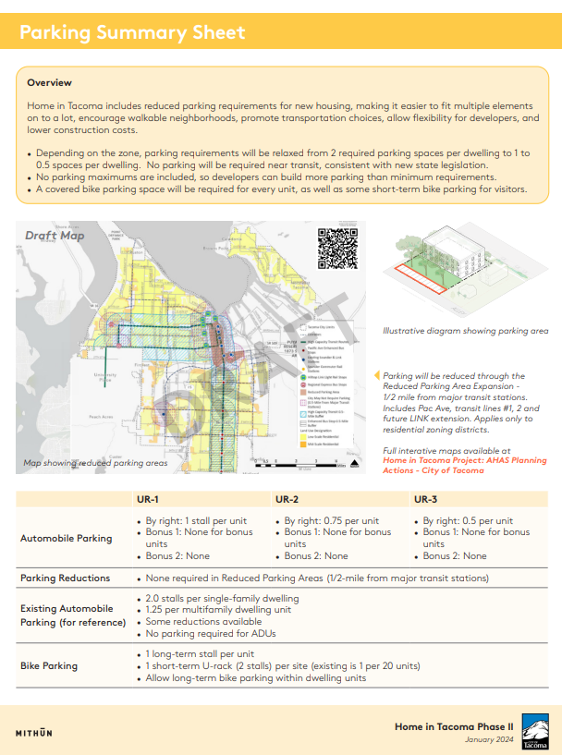
Summaries
Overview
Summaries
Zoning
Housing types
Parking
Landscaping and amenity space
Unit Lot Subdivisions
Affordability and building retention

Slide 6
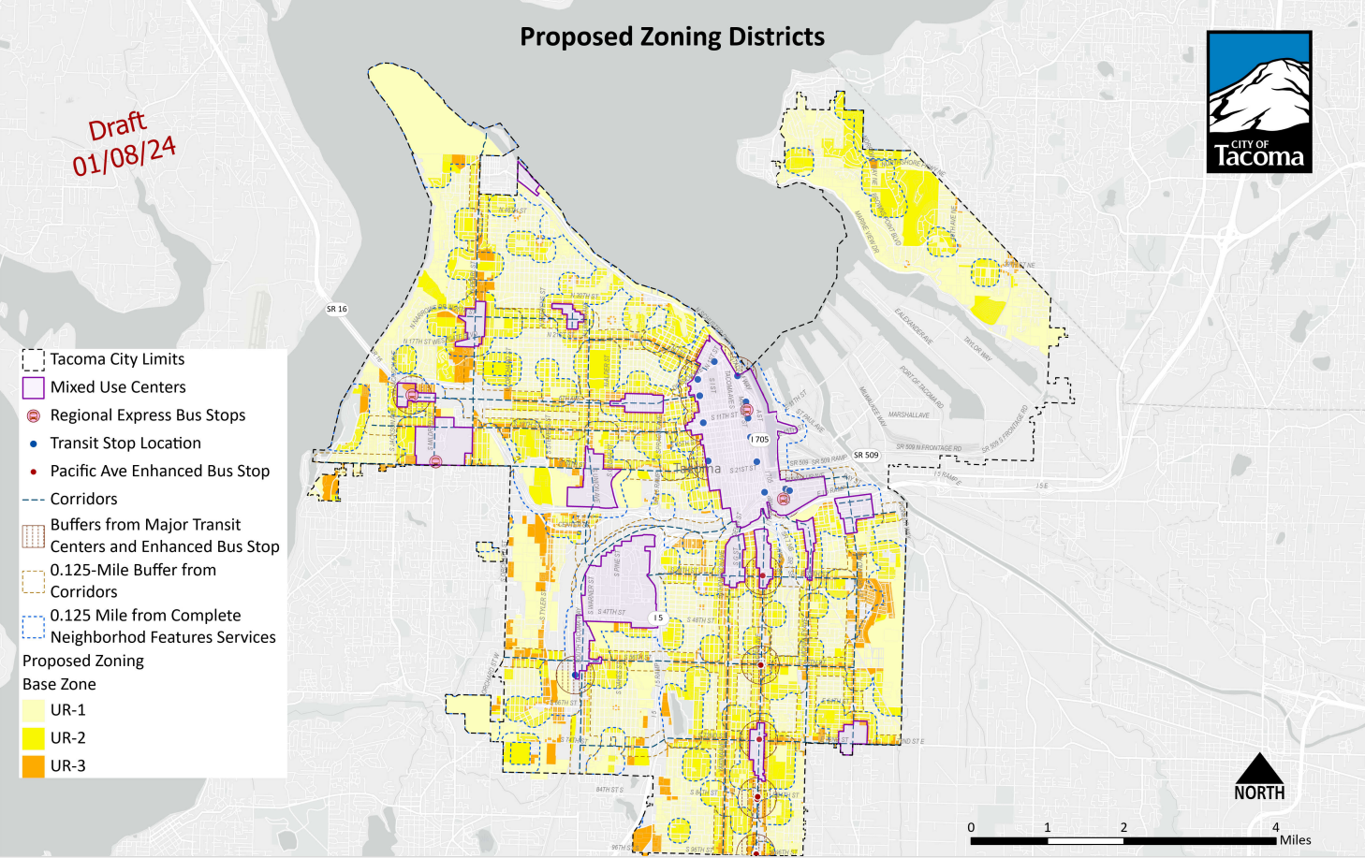
Proposed “Urban Residential” Zones
Follows Comp Plan, HIT 1 & HB 1110
Low-scale Residential = UR-1 or UR-2
Mid-scale Residential = UR-3
UR-2 in more walkable areas
1/8-mile of “complete neighborhood features”
1/4-mile of “major transit stations” (per HB 1110)
Existing PRD’s (outside of Parks/Open Space designations)
FINAL EDITS STILL IN PROGRESS
Notes:
Just show this with some explanation of how we got here- which they should already be caught up on

Slide 7
Proposed UR Zones
Baseline: Allowed “by right”
Bonus 1: 2 units/20% affordable (70%-80% AMI rental, 100% AMI ownership) or, building retained with infill
Bonus 2: Deeper affordability (60% AMI rental, 80% AMI ownership, all units for 50 years, no fee in lieu option), CUP required
Urban Residential (UR-1) ​ | Urban Residential (UR-2)​ | Urban Residential (UR-3)
​Baseline: 1/1500 sf (4 per lot) ​ Bonus 1: 1/1000 sf (6 per lot) Bonus 2: 1/750 sf (8 per lot) ​ | Baseline: 1/1000 sf (6 per lot) ​ Bonus 1: 1/750 sf (8 per lot) ​ Bonus 2: 1/500 sf (12 per lot) | Baseline: 1/750 sf (8 per lot) ​ Bonus 1: 1/500 sf (12 per lot) ​ Bonus 2: 1/375 sf (16 per lot)
Baseline 1-2 units: 0.6, 3+ units: 0.8 Bonus 1: 1.0 Bonus 2: 1.2 | Baseline 1-2 units: 0.8, 3+ units: 1.0 Bonus 1: 1.2 Bonus 2: 1.6 | Baseline 1-2 units: 1.0, 3+ units: 1.2 Bonus 1: 1.6 Bonus 2: 2.0
Baseline: 35 ft (25 ft rear yard) Bonus 1: 35 ft rear yard Bonus 2: Same | Baseline: 35 ft (25 ft rear yard) Bonus 1: 35 ft rear yard Bonus 2: Same | Baseline: 35 ft Bonus 1: 45 ft (4 stories) Bonus 2: 45 ft (5 stories)
Baseline: 1 stall per dwelling Bonus 1: None for bonus units Bonus 2: None for project | Baseline: 0.75 per dwelling Bonus 1: None for bonus units Bonus 2: None for project | Baseline: 0.5 per dwelling Bonus 1: None for bonus units Bonus 2: None for project
Density
FAR
Height
Parking
Density assumes a typical 6000 sf lot; 4 units + 2 bonus allowed on pre-existing lots

Slide 8
Reduced Parking Areas
No parking required (except accessible)
½-mile from major transit stations, transit routes #1, 2
Applies only to UR Zones

Slide 9
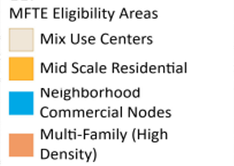
Residential Target Areas
Authorizes use of Multifamily Tax Exemption Program (with affordability) in more areas
Mixed-Use Centers
Neighborhood Commercial Nodes
Mid-scale Residential areas
Multifamily High-density areas

Slide 10
TMC Changes Guide
1.37 Transfer of Development Rights Program Administrative Code: Minor change for consistency with UR zoning
1.39 Affordable Housing Bonuses Administrative Code: Updates affordability bonuses process and requirements
13.01.010 Definitions: Adds and updates terms to address HIT package (middle housing, household, major transit, etc.)
13.04 Platting and Subdivisions: Adds Unit Lot Subdivision standards, removes Planned Residential Districts (PRDs)
13.05.010 Land Use Permits and Procedures: Updates CUPs - removes Special Review District, Infill Pilot; updates Special Needs Housing, reuse of Historic Structures, Affordable Housing Bonus
13.06 Zoning
13.06.010 General Provisions: Updates zoning map and general zoning standards
13.06.020 Residential Districts: Replaces current zoning with proposed UR Districts and UR standards
13.06.030 Commercial Districts/13.06.040 Mixed-Use Centers/13.06.060 Industrial: Consistency updates
13.06.070 Overlay Districts: Updates re: modifications to existing PRDs, Airport Compatibility District min. lot size
13.06.080 Special Use Standards: Updates for ADUs, residential businesses, short-term rentals, special needs housing; removes Cottage Housing
13.06.090 Site Development Standards: Updates landscaping, parking, pedestrian and bike, other standards
13.06.100 Building Design Standards: Adds HIT middle housing standards, re-organizes other residential standards
13.12 Environmental Code: Increases threshold for SEPA review; adds traffic, archaeologic and soils standards
13.17 Residential Target Areas: Adds new areas to the RTA

Slide 11
Site planning exercise
Evaluates functionality and use of space under proposed housing standards
Identifies
HIT package changes
Utilities and access standards updates
Topics for ongoing study
Landscaping code – final decisions (tree retention, fee in lieu)

Slide 12
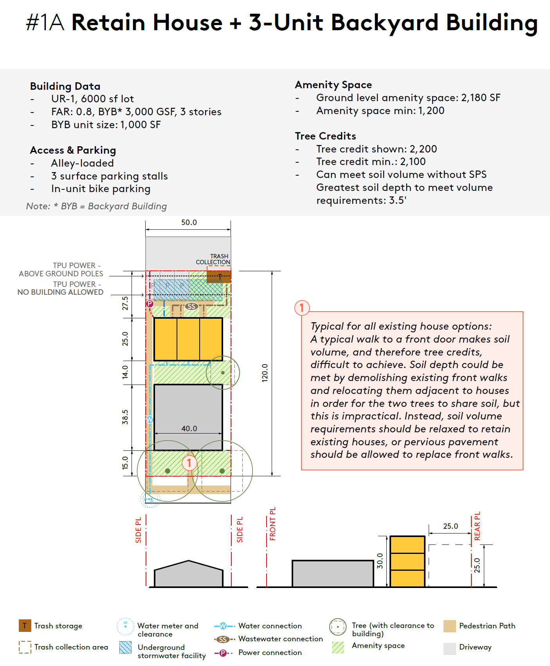
Site planning exercise – does everything fit?
EXAMPLE
Tested 6 scenarios (typical lots, upper end of density range)
Integrated HIT package AND proposed access and utilities standards
Consulted with Tacoma Permit Advisory Group

Slide 13
Conclusions
EXAMPLE
The package generally works, though it can be a tight fit
Zoning and land use standards are close
Utilities & access standards updates are critical
Not every site can develop to max densities (due to site conditions like soils, trees, slopes, lack of infrastructure)

Slide 14
Site plan study - Recommendations
HIT package – for bonus projects
Proposal already offers density, FAR, parking, height bonuses
Staff recommend (in addition)
Tree credits reduction by 5% (ex., UR-1 35% becomes 30%)
Front setbacks reduced by 5 ft (varies by zone – min. would be 5 ft)
Amenity space (UR-1 and UR-2) - reduced by 50 ft per bonus level; UR-3 - by 25 ft per bonus level
Utilities & access standards
Reduced requirements for parking, driveway, ped path dimensions
Shared utilities services allowed
Future actions
Monitor outcomes & study further standards changes

Slide 15
Engagement
Seeking broad, equitable and effective public engagement

Slide 16
Event Schedule
Tuesday, February 20, 6-7:30 p.m. on Zoom
Thursday, February 22, 6-7:30 p.m. at Bates Technical College South Campus, 2201 S. 78th St.
Wednesday, February 28, 6-7:30 p.m. at University of Puget Sound Upper Marshall Hall, 1500 N. Warner St.
Saturday, March 2, 2-4 p.m. at Eastside Community Center Social Hall, 1721 E 56th St.
Additional Outreach
Community presentations- Neighborhood Councils, Commissions, Community groups
Event Tabling- MLK day, Lincoln Lunar New Year, Tet Festival
Language access- Language/Cultural Ambassadors at March 2nd event, materials in top languages
Housing Equity Champions- engaged throughout
Mailer coming soon!
Notes:
Ask about what would be needed to provide authorization for public hearing…

